Slide 1
Regulatory Requirements Tool Based on GenAI
Anna Almassy
Supervision: Dr Gabor Sarosi

Slide 2
Content
Introduction and Challenges in Credit Risk Modelling
Motivation and Use Cases
Technical Overview
Performance Evaluation
Future Work and Improvements
Demo of the Chatbot
Q&A

Slide 3
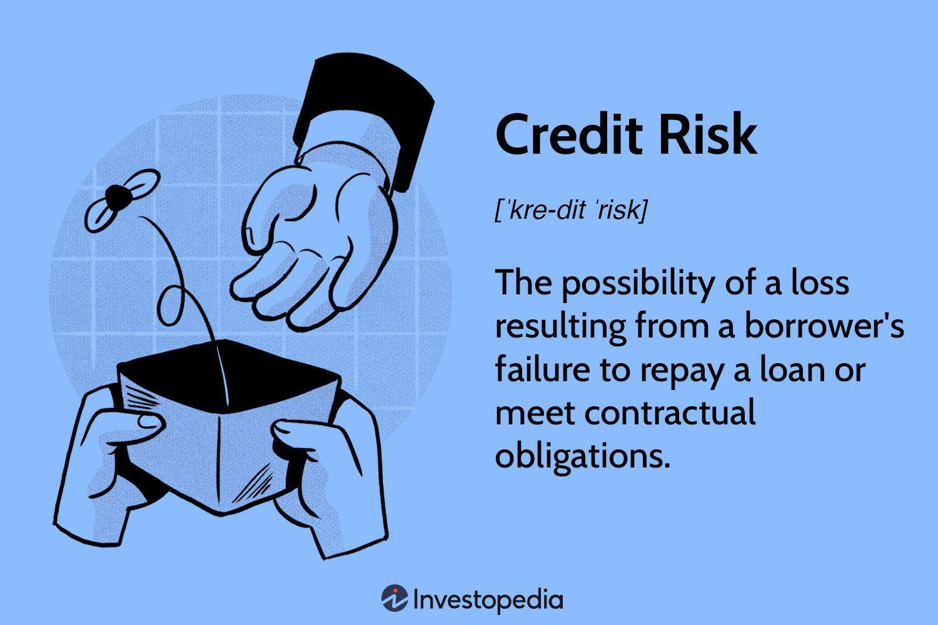
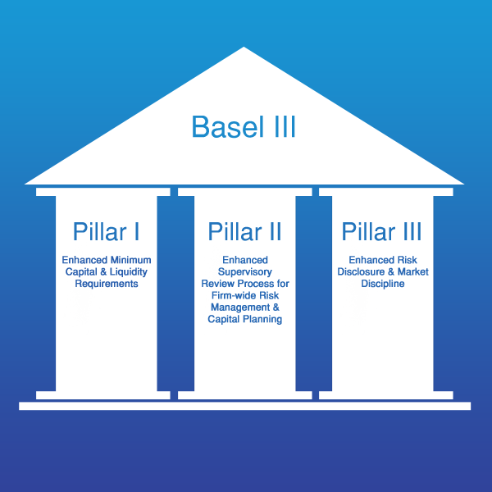
Introduction Background
Credit Risk Modelling
Basel Framework Overview
Role of Basel Framework in Credit Risk Modelling
Increased Capital Requirements
Standardized Risk Measures
Leverage and Liquidity Ratios
Operational and Trading Risk
Notes:
The Basel framework, created by the Basel Committee on Banking Supervision, provides a set of regulations within the banking sector. This framework has evolved over time, starting with Basel I, moving through Basel II, and now we have Basel III, which is transitioning into what we call the 'Basel III Endgame’. The first pillar focuses on maintaining sufficient capital, the second on supervisory oversight, and the third on market discipline through transparency and disclosure.
One of the major impacts of Basel III is the increased capital requirements for banks. This means banks must hold more capital against potential losses. This impacts credit risk models as they need to accurately estimate the probability of default (PD), loss given default (LGD), and exposure at default (EAD) to determine the appropriate capital reserves.
The framework also introduces standardized risk measures to promote consistency and comparability across the banking industry. Credit risk models must align with these standardized risk weights for different asset classes to ensure that capital charges are calculated correctly.
Leverage and Liquidity ratios: Credit risk models need to incorporate these ratios into stress testing and scenario analysis to ensure banks can meet their obligations during financial stress.
including operational and trading risk assessment. Credit risk models must consider the impacts of these risks to ensure that all potential threats to a bank's stability are adequately covered.

Slide 4
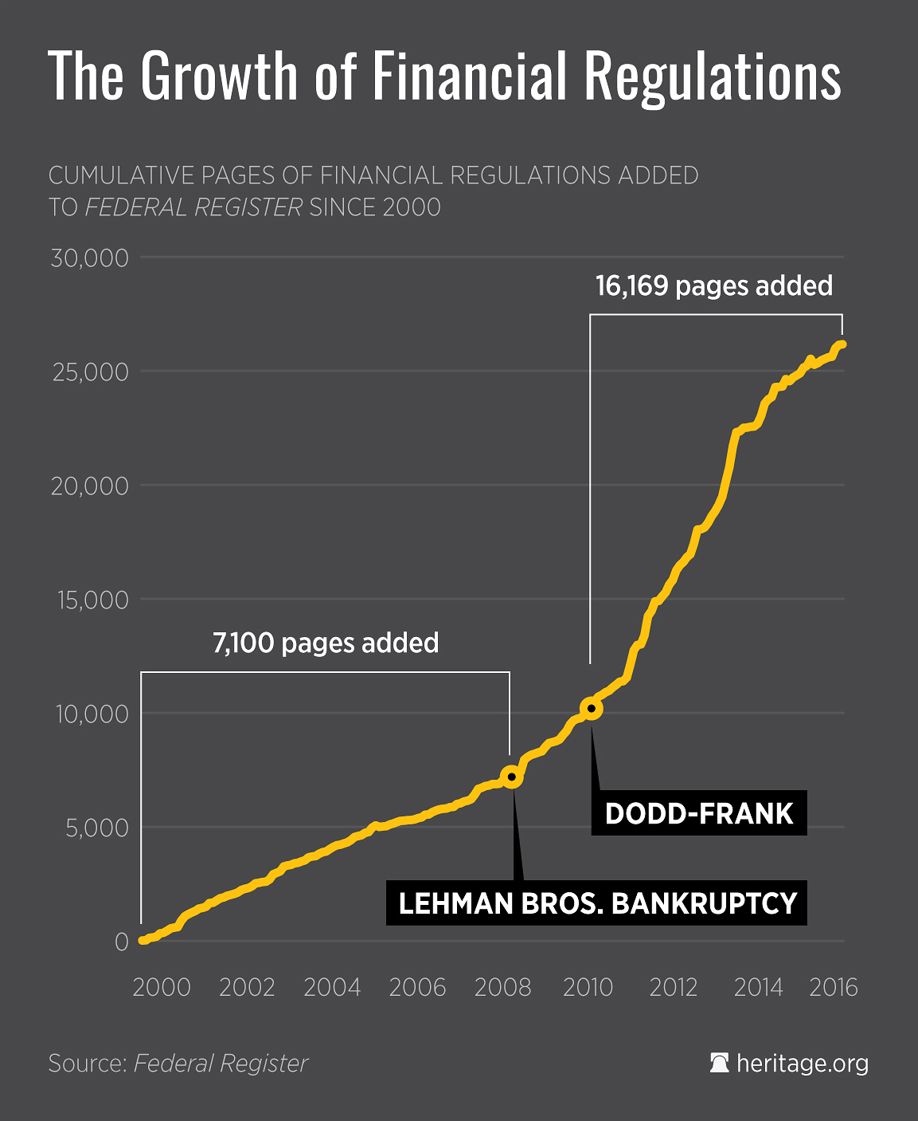
Introduction Motivation and Challenges
Interpreting complex regulatory text
Keeping up with frequent regulatory updates
Ensuring accuracy and completeness in compliance
Monitoring + Calibration of models
Stress Testing and Scenario Analysis
Documentation
Examples:
Compliance challenges in PD and LGD models.
Challenges in implementing downturn scenarios
Data collection requirements
Notes:
The graph on this slide shows the growth of financial regulations over time, highlighting the increasing complexity and volume of requirements that financial institutions must navigate. As you can see, the regulatory landscape has become more demanding, necessitating advanced tools to manage compliance effectively.
One major challenge is interpreting complex regulatory text. Documents like the Basel framework are dense and technical, making it hard to extract necessary information quickly.
Additionally, regulations are frequently updated, requiring constant monitoring and adaptation to stay compliant.
Mistakes can lead to severe penalties.
Monitoring and calibration of models ensure they remain accurate over time, aligning with regulatory changes and market conditions.
Stress testing and scenario analysis help assess how models perform under different economic conditions, identifying potential vulnerabilities.
Documentation is vital for transparency and compliance.
Detailed records of models, including their assumptions and validation processes, are necessary for audits and regulatory reviews.

Slide 5
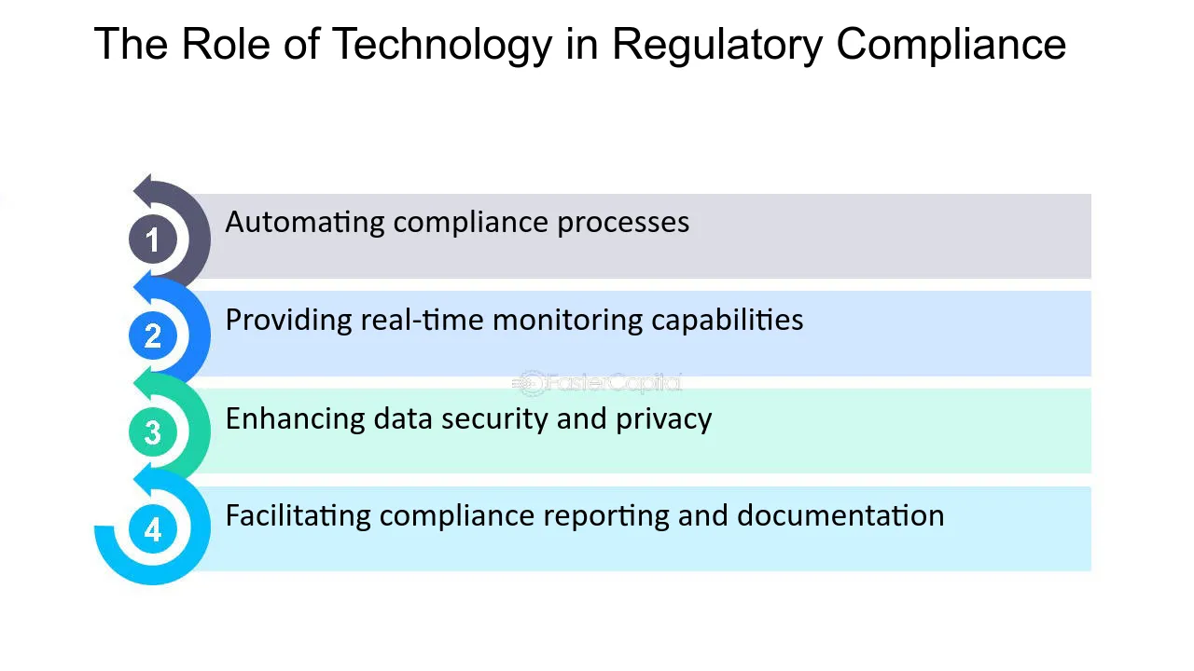
Introduction Motivation and Use Cases
Need for regulatory compliance in credit risk modelling
Complexity and volume of regulations
Role of technology in simplifying compliance
Use Cases Examples:
Assisting regulatory experts and model developers
Streamlining compliance checks
Automated updates and alerts for new regulations
Enhancing efficiency in documentation and reporting
Notes:
Technology can significantly simplify compliance processes. For instance, automating compliance checks can save time and reduce human error. Real-time monitoring capabilities allow for immediate detection and response to regulatory changes. Enhancing data security and privacy ensures that sensitive information is protected throughout the compliance process. Facilitating compliance reporting and documentation helps maintain detailed records required for audits and regulatory reviews.
Assisting regulatory experts and model developers: AI-driven chatbots can help experts quickly find and interpret relevant regulatory information, improving their efficiency and accuracy.
Streamlining compliance checks: Automated systems can continuously monitor for compliance, ensuring that all processes and models adhere to current regulations.
Automated updates and alerts for new regulations: Technology can provide automated alerts and updates whenever new regulations are introduced or existing ones are modified, keeping the institution up-to-date.
Enhancing efficiency in documentation and reporting: Tools that automate documentation and generate compliance reports can significantly reduce the workload and improve accuracy.

Slide 6
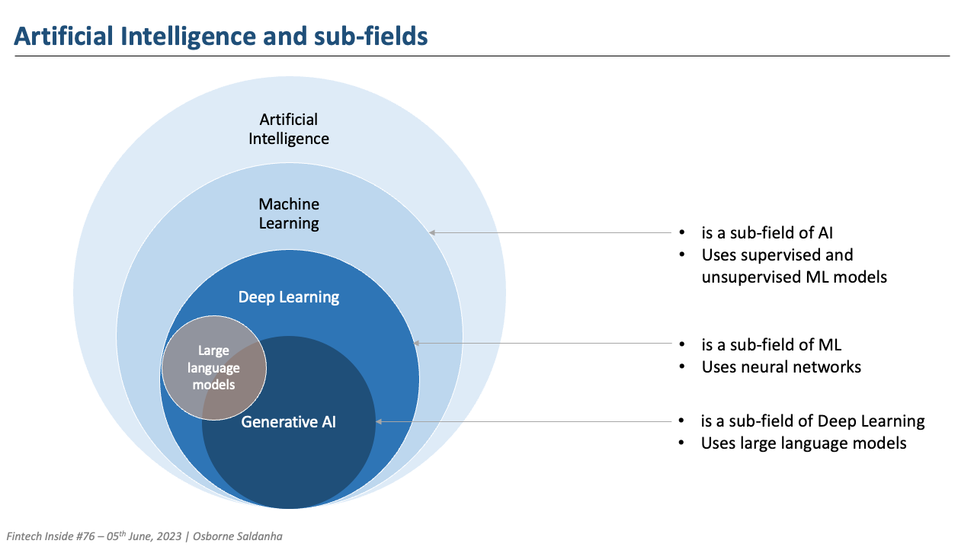
Technical Overview of the Chatbot GenAI and LLM
Feature | Generative AI (GenAI) | Large Language Models (LLM)
Scope | Broad (text, images, music, etc.) | Narrow (human language)
Core Technologies | GANs, VAEs, LLMs, Diffusion Models | Transformer Models
Training Data | Diverse (text, images, music, etc.) | Text Data
Applications | Image creation, music composition, text generation | Text completion, translation, summarization
Examples | DALL-E, MusicLM, ChatGPT | GPT-3, BERT, T5
Challenges | Diversity, bias, handling multiple data types | Context understanding, bias, ethical use
Notes:
Generative AI (GenAI) and Large Language Models (LLM) are two key areas within artificial intelligence, each serving distinct purposes. GenAI is a broad category that encompasses AI models capable of generating various types of content, from text and images to music and videos. It utilizes technologies like GANs, VAEs, and LLMs. In contrast, LLMs are a subset of GenAI specifically designed for understanding and generating human language, using transformer architectures.
Generative AI applications include tools like DALL-E for image creation and MusicLM for composing music, while LLMs like GPT-3 and BERT focus on text-based tasks such as language translation, text completion, and summarization.
Both technologies face unique challenges. GenAI must ensure content diversity and manage biases across different media types, whereas LLMs need to understand context and manage biases in textual data. We have seen in the past 1.5 the integration of these technologies has significantly advanced the capabilities of AI in various domains.

Slide 7
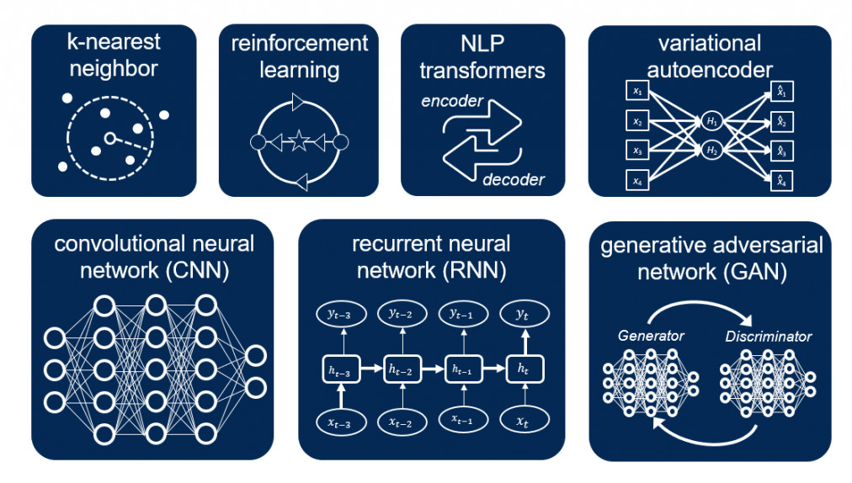
Technical Overview of the Chatbot GenAI and LLM
Notes:
This slide provides a brief overview of the technologies powering chatbots. Here are the key components:
NLP Transformers: These are the backbone of modern language models like ChatGPT. Transformers use self-attention mechanisms to process input data in parallel, making them highly efficient and effective for understanding and generating text. ChatGPT, specifically, is based on the GPT (Generative Pre-trained Transformer) architecture, which excels in natural language understanding and generation.
k-Nearest Neighbor (k-NN): Used for classification and regression by finding the 'k' closest data points in the feature space.
Reinforcement Learning (RL): Involves training an agent to make decisions by maximizing cumulative rewards. Useful for dynamic decision-making tasks.
Variational Autoencoder (VAE): Used for generating new data samples similar to the training data through an encoder-decoder structure.
Convolutional Neural Networks (CNNs): Primarily used in image processing but also applicable to text data, detecting features and patterns.
Recurrent Neural Networks (RNNs): Ideal for sequence data, maintaining context over time, useful for tasks like language modeling.
Generative Adversarial Networks (GANs): Consist of two neural networks that compete to generate realistic data.
Chatbot like gpt3 leverage these technologies, particularly transformers, to process and generate human-like text.

Slide 8
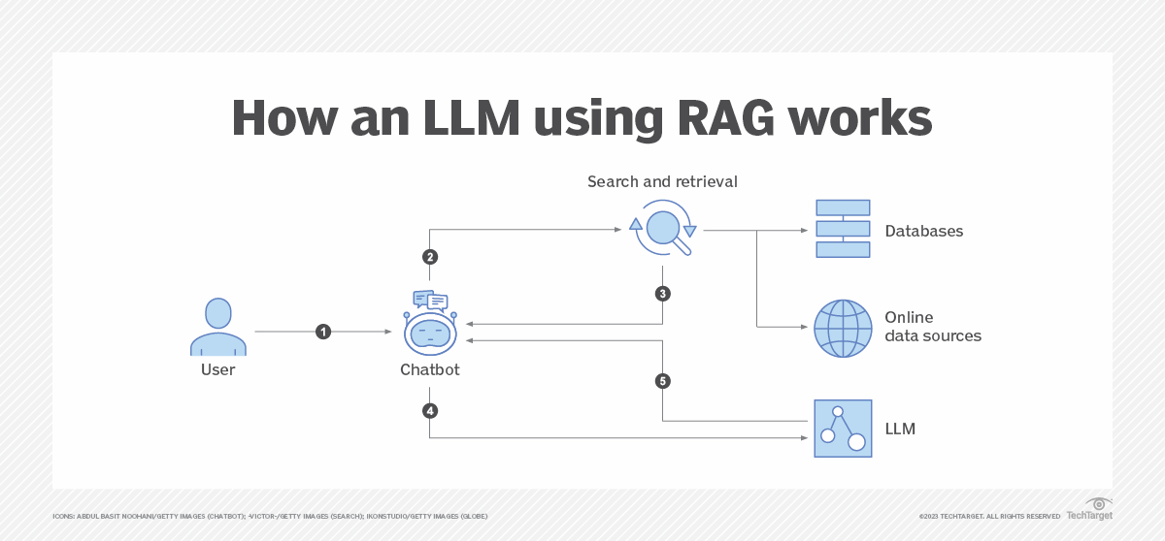
Technical Overview of the Chatbot Introduction to RAG and its Architecture
RAG (Retrieval-Augmented Generation) = information retrieval + text generation
Importance of RAG in improving chatbot responses
Components and interactions:
Notes:
This slide introduces the concept of Retrieval-Augmented Generation, or RAG. RAG is a powerful approach that combines two key elements: information retrieval and text generation.
Importance of RAG in Improving Chatbot Responses:
Accuracy: By retrieving relevant RAG ensures that the generated responses are based on up-to-date and accurate information.
Relevance: The integration of information retrieval allows the chatbot to provide contextually relevant answers, improving the overall user experience.
Efficiency: RAG streamlines the process of generating responses by combining the strengths of retrieval and generation, making the chatbot more efficient in handling complex queries.
User Query: The process starts with the user submitting a query.
Vectorized Database: The query is used to search the database
Information Retrieval: retrieves the most relevant documents based on the query.
Text Generation: The language model, using the retrieved documents and its pre-trained knowledge, generates a coherent and contextually appropriate response.
Response Delivery: The generated response is delivered to the user

Slide 9
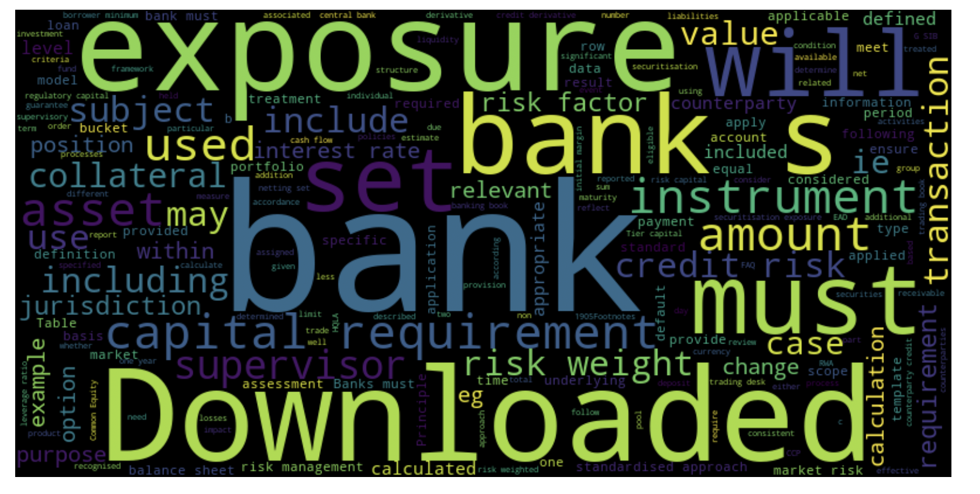
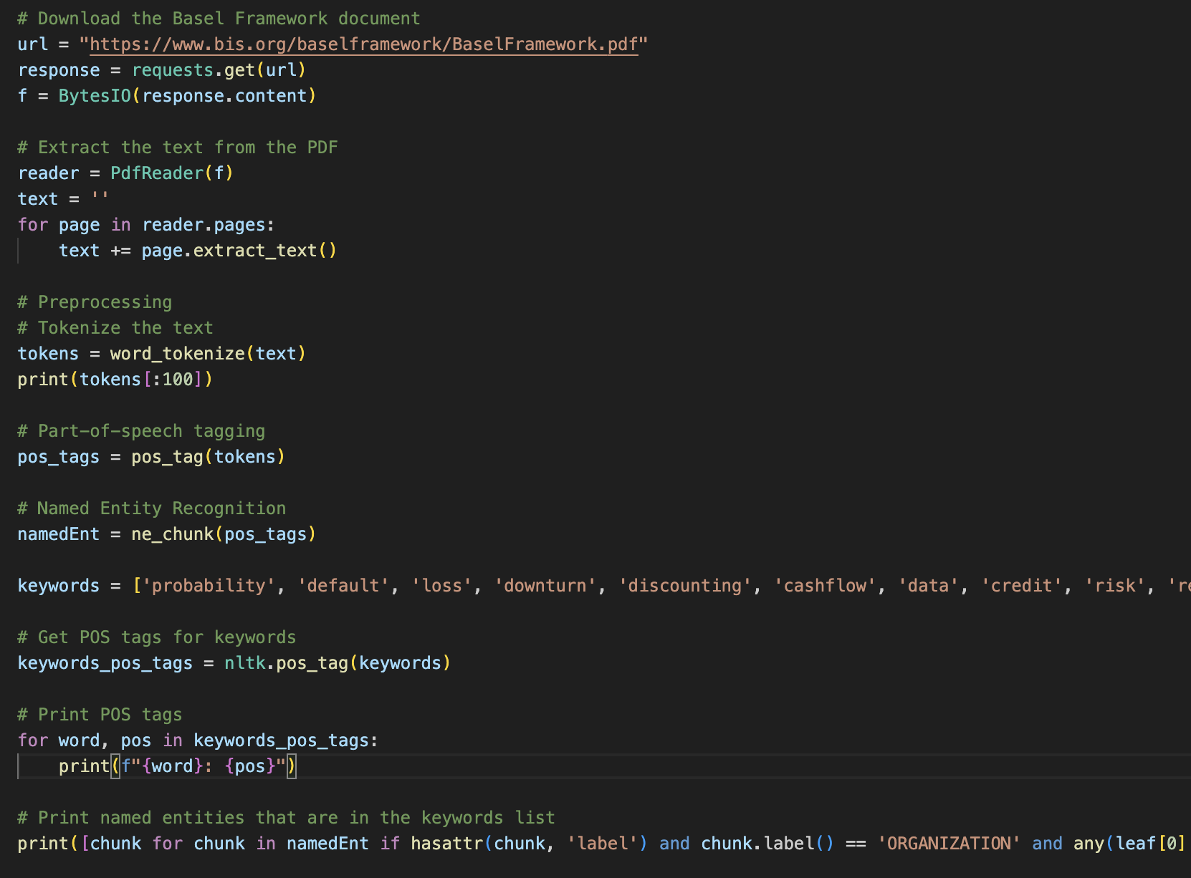
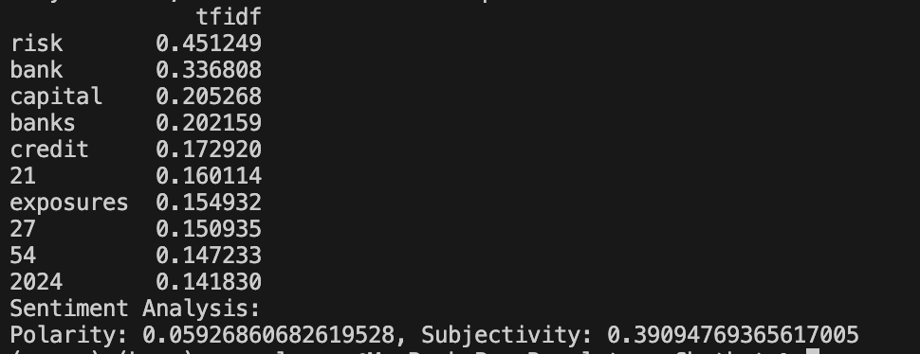
Technical Overview of the Chatbot Data Exploration
Notes:
As the first step, I downloaded the Basel framework document and extracted its text content. This raw text was then tokenized, which means splitting it into individual words or tokens. Here are the main steps I followed:
Tokenization: Breaking down the text into individual words for easier processing.
Part-of-Speech Tagging and Named Entity Recognition (NER): Annotating each word with its part of speech and identifying named entities like organizations and key terms relevant to our domain.
Keyword Identification: Focusing on important terms such as 'probability', 'default', 'loss', 'downturn', 'discounting', 'cashflow', 'data', 'credit', 'risk', and 'requirements'.
The word cloud visualizes the most frequently occurring terms in the document. This helps us quickly identify the dominant themes and important concepts within the Basel framework.
Next, I performed a TF-IDF (Term Frequency-Inverse Document Frequency) analysis. This method highlights terms that are important within the document by considering their frequency and how unique they are. The top TF-IDF scores indicate the most significant words in the context of the Basel framework.
Additionally, I conducted a sentiment analysis using the TextBlob library, which provided insights into the overall sentiment of the document. Score indicates neutral and objective. (39%)

Slide 10
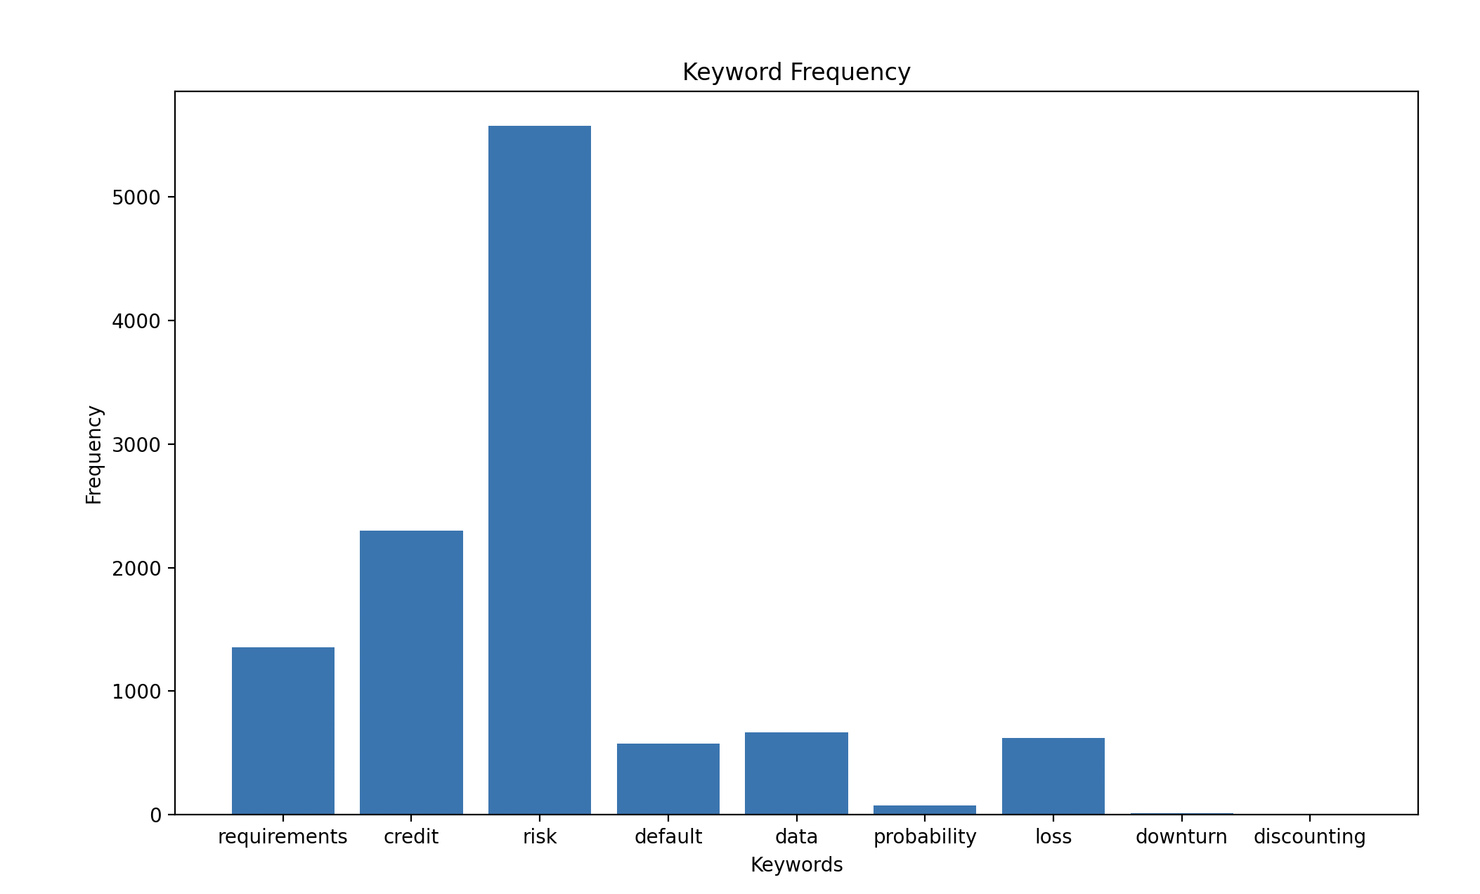
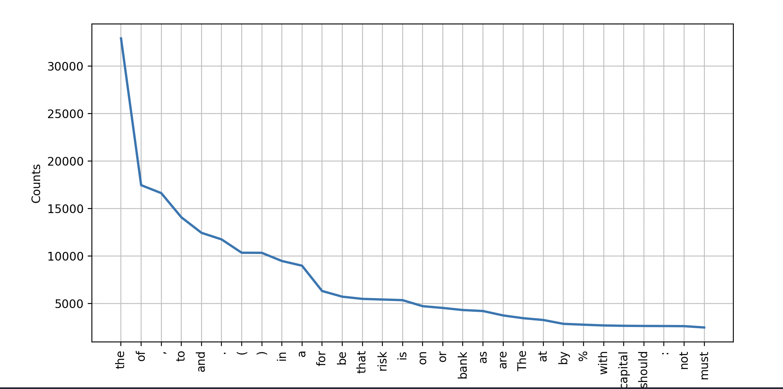
Technical Overview of the Chatbot Data Exploration
Notes:
Continuing with our data exploration, I generated frequency distributions and keyword counts for specific terms.
Keyword Frequency Distribution: The frequency distribution plot shows the 30 most common tokens in the document. This helps in understanding the distribution and repetition of terms.
Keyword Counts: I specifically counted the occurrences of our predefined keywords. This bar chart visualizes how often these critical terms appear, providing insights into their prominence in the Basel framework.
These visualizations and analyses were crucial for two reasons:
They helped in understanding the structure and key elements of the Basel framework.
They informed the design of our retrieval-augmented generation system by highlighting the most relevant terms and concepts to focus on which gives insight on how to use the system

Slide 11


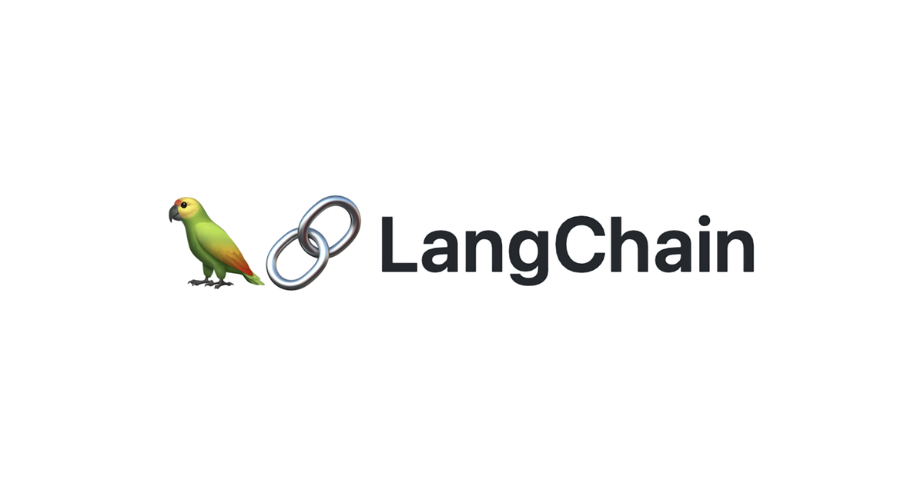
Technical Overview of the Chatbot Detailed Architecture
Document Retrieval System
Vectorization process and similarity search
Pre-trained Language Model (e.g., GPT-3)
Combining retrieved information with language model generation

Slide 12
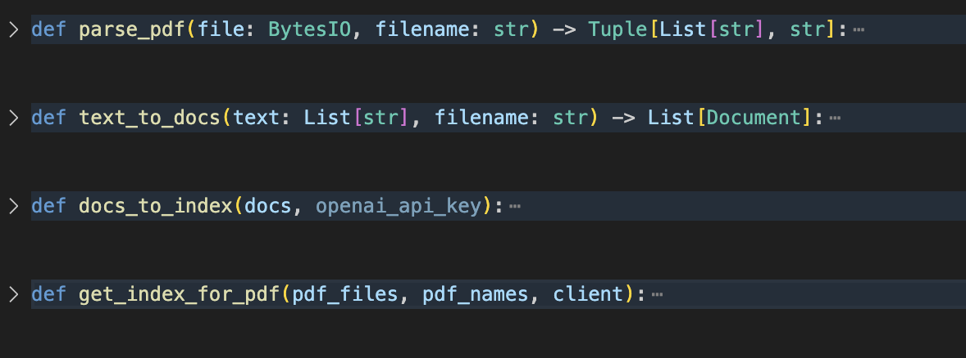
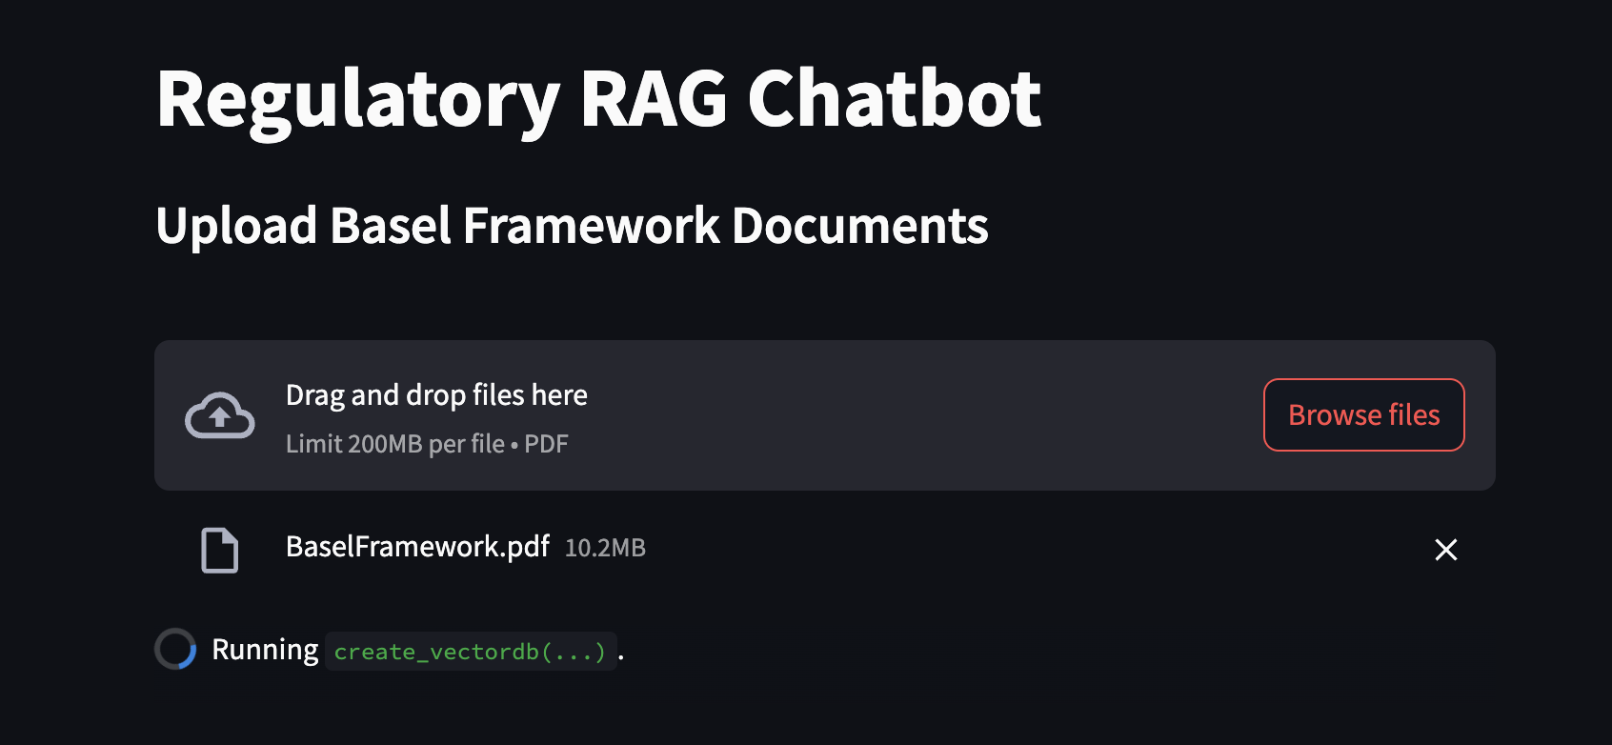
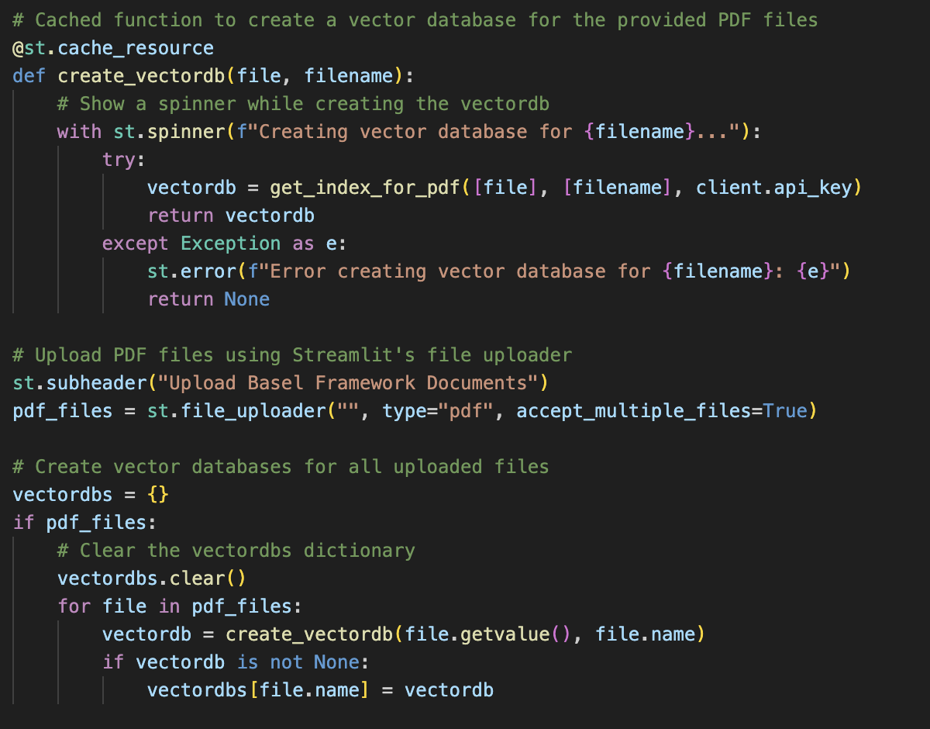
Technical Overview of the Chatbot Detailed Architecture - Vectorization
Notes:
I created the function create_vectordb for processing and vectorizing PDF documents. It starts by taking PDF files and their filenames as input and processes these files to create a vector database.
We begin by extracting text from the PDFs using a PDF reader. The extracted text is then split into smaller, more manageable chunks. Each chunk is converted into a numerical vector using a text embedding model. These vectors are stored in a vector database, allowing for quick and efficient similarity searches.
Vectorization is the process of converting text into numerical vectors. In this process, each word or phrase is mapped to a point in a high-dimensional space. Similar texts are positioned closer together in this space. This conversion allows us to perform efficient similarity searches by comparing these vectors.
I used FAISS (Facebook AI Similarity Search) to manage our vector database. FAISS is a library developed by Facebook AI, designed for efficient similarity search and clustering of dense vectors. It's particularly suited for high-dimensional data and large datasets, making it an ideal choice for our use case.

Slide 13
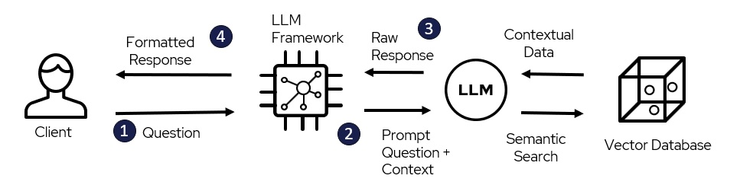
Technical Overview of the Chatbot Detailed Architecture – Response Generation
"" You are a Credit Analyst who evaluates financial information and risks based on the contents of PDF documents provided to you. Provide concise and focused answers, emphasizing financial implications, risk assessment, and relevant financial metrics. Focus on the 'page' or 'section' in your citations to specify where the relevant information was found. Be sure to mention the page number or section at the end of your responses for any data or insights you reference from the PDF. If the content from the PDF does not pertain to credit analysis or risk assessment, reply with 'Not applicable'.
The PDF content to analyze is:
{pdf_extract} ""
Notes:
When a user submits a question, the system processes this query through several stages.
First, the query is tokenized and converted into a vector. This vector is then compared with vectors in the vector database to retrieve relevant document chunks. The retrieval stage involves finding the most similar document chunks to the user's query. These chunks are identified based on their vector similarity to the query vector. The retrieved document chunks are integrated into a predefined prompt template. This template ensures that the context from the documents is used to guide the language model's response generation.
The language model (GPT-3.5) uses the contextual prompt to generate a response.
The generated response is streamed back to the user, updating in real-time as it is generated.
The key advantage of combining retrieval and generation is that it ensures the responses are not only relevant but also grounded in the specific content of the provided documents. This hybrid approach enhances the accuracy and reliability of the chatbot's answers."

Slide 14

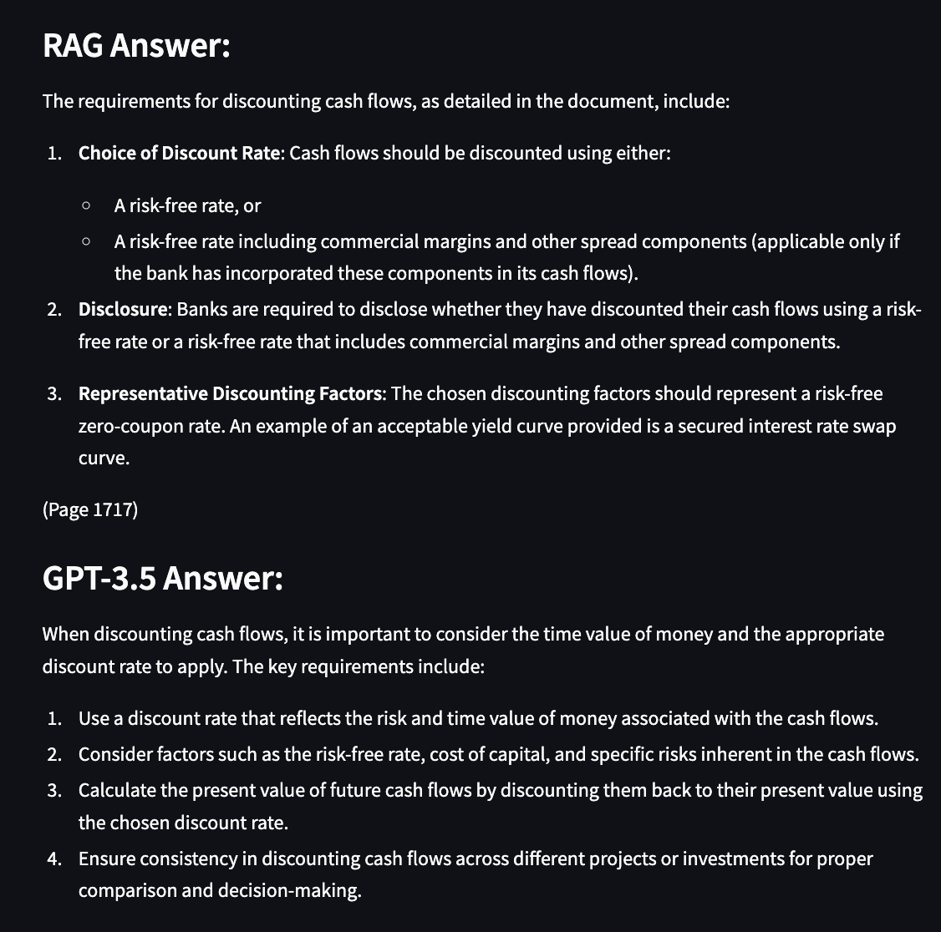
Performance Evaluation
ChatGPT3 vs RAG
Expert answer vs RAG
ROUGE Scores
Notes:
In this section, we will evaluate the performance of our chatbot by comparing responses generated using two different models: ChatGPT-3.5 and the Retrieval-Augmented Generation (RAG) model. Additionally, I provided an option to compare these responses with expert answers to assess accuracy and relevance. First, let's compare the performance between ChatGPT-3.5 and our RAG model. ChatGPT-3.5 is a robust language model, but it generates responses based solely on its training data. The RAG model, on the other hand, enhances responses by retrieving relevant information from specific documents, making it more contextually accurate. To quantify the performance, I used ROUGE scores. ROUGE, which stands for Recall-Oriented Understudy for Gisting Evaluation, is a set of metrics used to evaluate the quality of text summaries by comparing them to reference summaries.

Slide 15
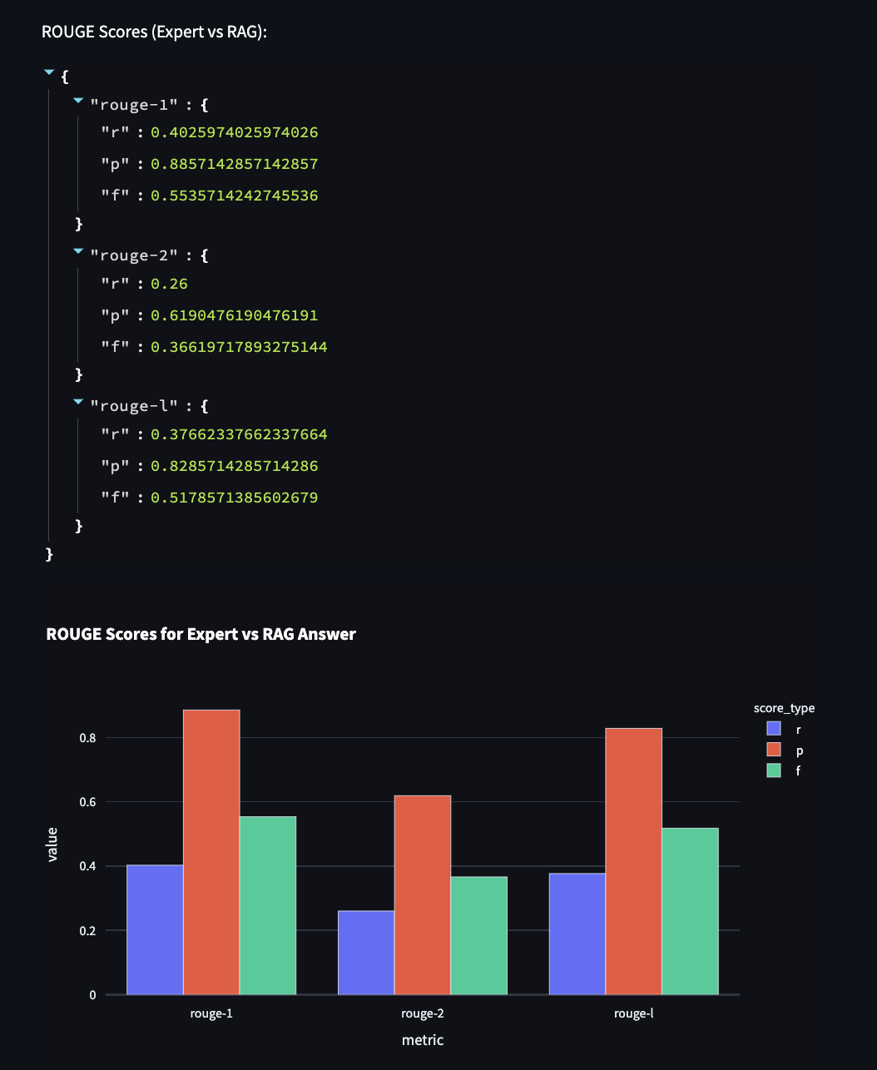
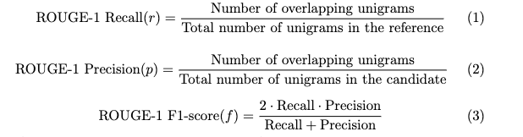
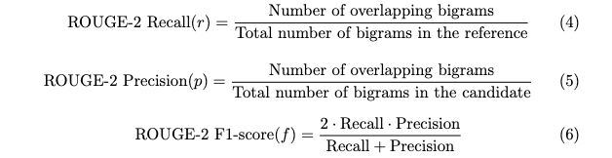
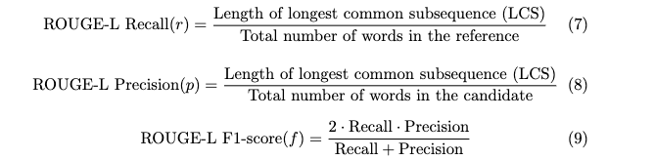
Performance Evaluation
Notes:
ROUGE-1: Measures the overlap of unigrams (single words) between the generated text and the reference text.
ROUGE-2: Measures the overlap of bigrams (two-word sequences) between the generated text and the reference text.
ROUGE-L: Measures the longest common subsequence (LCS) between the generated text and the reference text.
The recall of 0.4026 means that the RAG model retrieved 40.26% of the relevant unigrams (single words) present in the expert answers. This indicates that the RAG model is quite effective in capturing individual words from the reference text.
"The precision of 0.8857 shows that 88.57% of the unigrams in the generated answers were relevant to the expert answers. This suggests that the RAG model is highly accurate in including relevant words in its responses.”
"The F1-score of 0.5536 provides a balanced measure of both precision and recall. This indicates that the RAG model performs well in terms of retrieving and generating relevant individual words with high accuracy.”
"The precision of 0.6190 shows that 61.90% of the bigrams in the generated answers were relevant to the expert answers. This indicates that while the model captures some contextual phrases, there is still room for improvement.”
"The recall of 0.3766 for ROUGE-L indicates that the RAG model retrieved 37.66% of the longest common subsequences present in the expert answers. This shows that the model is effective in capturing longer contextually relevant sequences.”
"The precision of 0.8286 demonstrates that 82.86% of the longest common subsequences in the generated answers were relevant. This suggests that the RAG model balances relevance and context effectively."
These ROUGE scores demonstrate that the RAG model generally performs well, especially in capturing relevant words and longer sequences, though there is still room for improvement in capturing two-word. The comparison with expert answers shows that the RAG model provides responses that align closely with expert insights, making it a valuable tool for regulatory compliance in credit risk modeling.

Slide 16
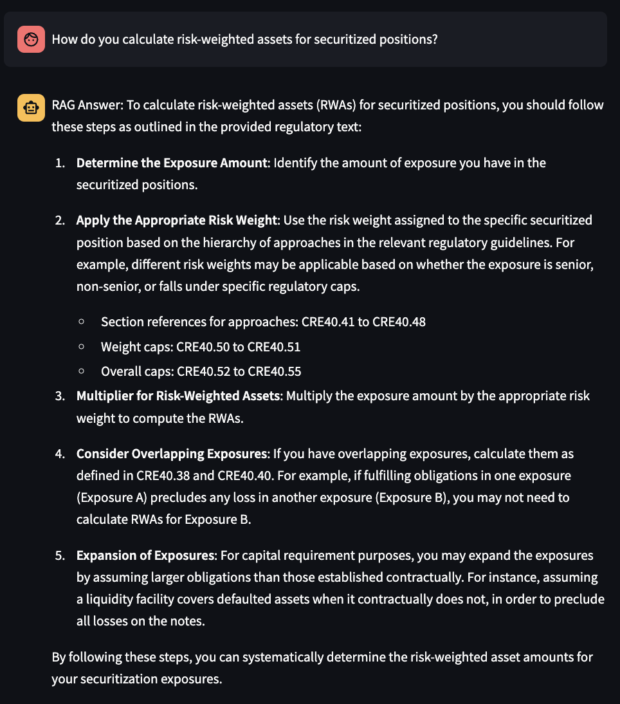
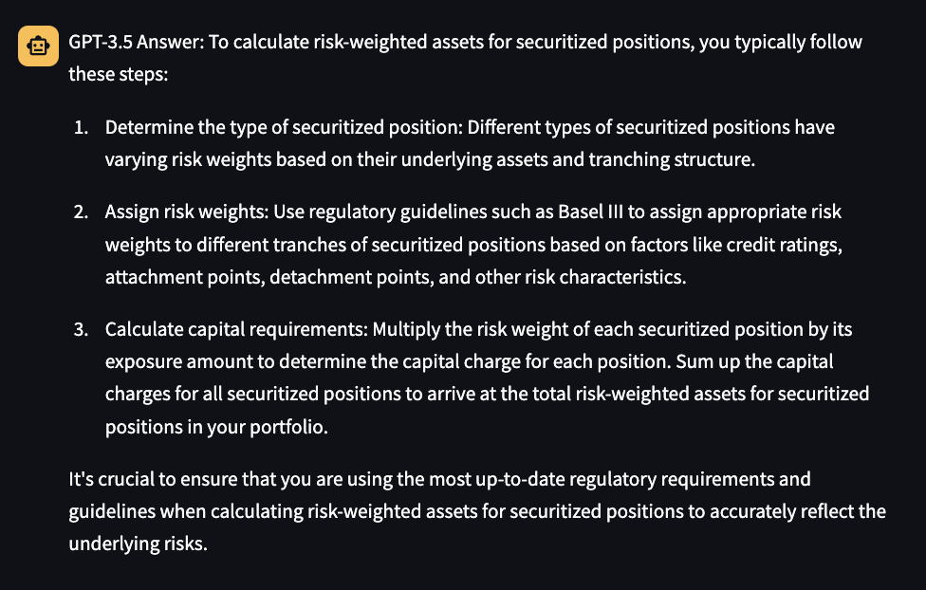
Performance Evaluation Equations
Notes:
A significant limitation of these models is their struggle with interpreting and processing non-textual data. This includes images, complex diagrams, and particularly equations embedded as images or in graphical format. The models can't directly read the content of these images or understand their mathematical implications.
When confronted with an equation or formula presented as an image, the model cannot 'read' the equation. Instead, it can only describe the image based on the context or any accompanying text. This often results in descriptions that outline the steps or principles involved, rather than the exact mathematical expressions.

Slide 17

Future Work and Improvments
Ideas that came up:
Use webscraping (computationally less expensive but can only work with specially targeted queries and if users know what they are looking for)
Maybe a hybrid approach?
Trying out different language models, fine-tuning
Comparing documents:
Compare different versions of Basel framework (what changed)
Compare Model Documentation with Basel Framework
Information is merged in the vector database
Create separate databases for each document?
Notes:
A hybrid approach might balance the benefits of both methods. For instance, using web scraping to identify and extract the most relevant sections of the Basel framework, and then embedding and vectorizing only those sections. This can optimize computational resources while ensuring detailed and contextually accurate responses.
Handling multiple documents within the Retrieval-Augmented Generation (RAG) framework presents significant challenges, primarily due to issues in creating, separating, and comparing vector databases. When multiple PDF documents are uploaded and processed together, they often merge into a single vector database, making it difficult to distinguish between individual documents. This can lead to inaccuracies during information retrieval and complicates tasks like comparing different versions of the Basel framework or aligning model documentation with regulatory standards. Potential solutions include creating separate vector databases for each document to ensure context is maintained, enhancing metadata tagging for better differentiation, and developing advanced query mechanisms that can handle multiple databases simultaneously. These approaches aim to improve the accuracy and efficiency of the RAG chatbot in processing and comparing regulatory texts, ensuring compliance with evolving regulations

Slide 18
Thank you! Questions?

